Slide 1
How to Teach Computers to Recognize Things S1: What, Why, How
Dr. Du Pengfei
CPPS/DMD
23 Mar 2023

Slide 2
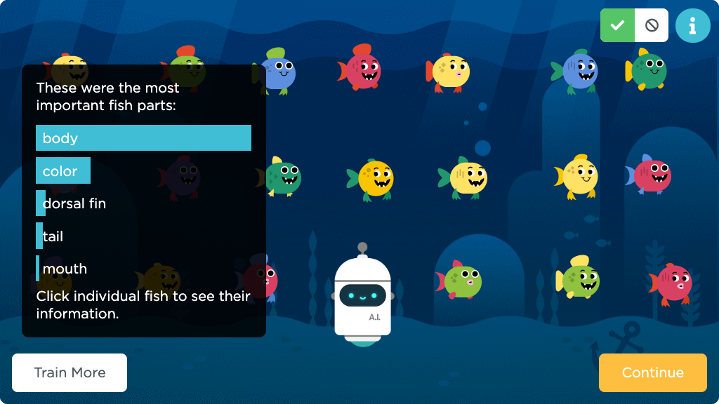
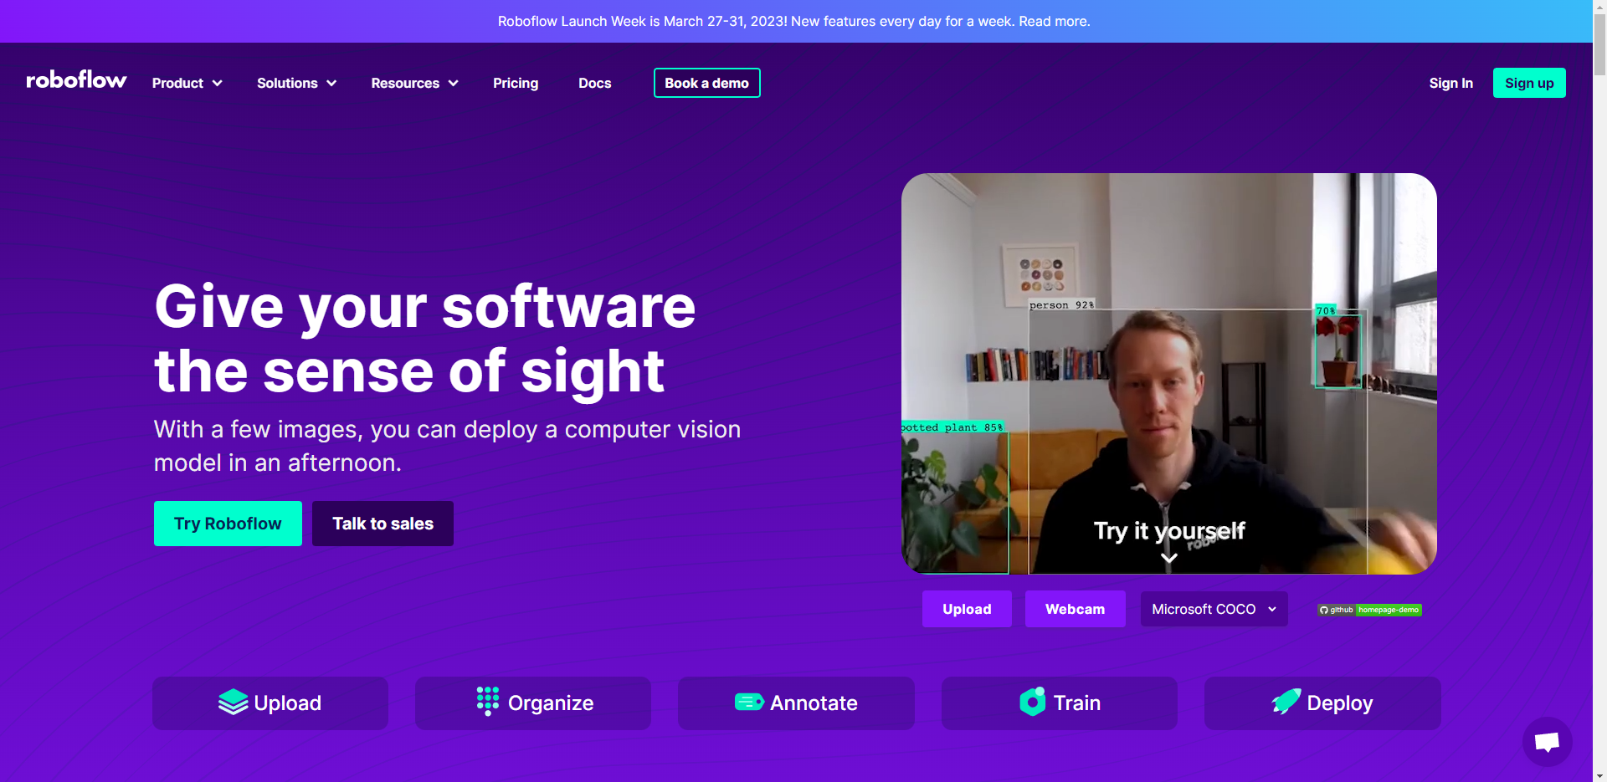
Agenda
First half: Warm-up and A.I. Training Game
Second half: Preparing For Our Real A.I. Training Projects
Notes:
https://www.youtube.com/watch?v=2hXG8v8p0KM

Slide 3
Warm UP: Machine Learning
https://www.youtube.com/watch?v=2hXG8v8p0KM
Quick Share-out: Where have you seen or experienced artificial intelligence in your lives?
Examples from the video include:
email filters
auto-complete text
video recommendation systems
voice recognition
translation apps
digital assistants
image recognition
Notes:
https://www.youtube.com/watch?v=2hXG8v8p0KM

Slide 4
Hands on: Train A.I. to clean the ocean (L1~4)
https://studio.code.org/s/oceans/lessons/1/levels/2
A.I. needs us to train and teach them!
We are the teachers of robots, and A.I.
Each student to label 30 images, then iterate the testing results with next one’s 30 more annotations
consistently label things correctly should see an ocean full of different types of sea creatures, without much (or any) other objects.
Notes:
https://www.youtube.com/watch?v=2hXG8v8p0KM

Slide 5
Hands on: Train Data and Bias (L5)
https://www.youtube.com/watch?v=x2mRoFNm22g
Quick Share-out: How well did A.I. do? How do you think it decided what to include in the ocean?
Data is Code!!
A.I. only learns what we taught !
Notes:
https://www.youtube.com/watch?v=2hXG8v8p0KM

Slide 6
Extension: Using Training Data for Types of Fish (L6)
https://studio.code.org/s/oceans/lessons/1/levels/6
Each student to label 30 images, then iterate the testing results with next one’s 30 more annotations
consistently label things correctly should tell different types of fish.
Notes:
https://www.youtube.com/watch?v=2hXG8v8p0KM

Slide 7
Wrap UP: A.I. Impact on Society (L7)
https://www.youtube.com/watch?v=ng4c1g3COfs
Artificial intelligence systems learn from the data we give it, but that data could be opinion-based or biased.
Think of a time where machine learning might have got something wrong in the real world?
https://www.youtube.com/watch?v=_-E36V73VOg
Notes:
https://www.youtube.com/watch?v=2hXG8v8p0KM

Slide 8

Extension: Teach A.I. a new word (L8)
https://studio.code.org/s/oceans/lessons/1/levels/8
Subject word needs our understanding and reasoning!
Each student to label 30 images, then iterate the testing results with next one’s 30 more annotations
consistently label things correctly should see an ocean full of different types of sea creatures, without much (or any) other objects.
Notes:
https://www.youtube.com/watch?v=2hXG8v8p0KM

Slide 9
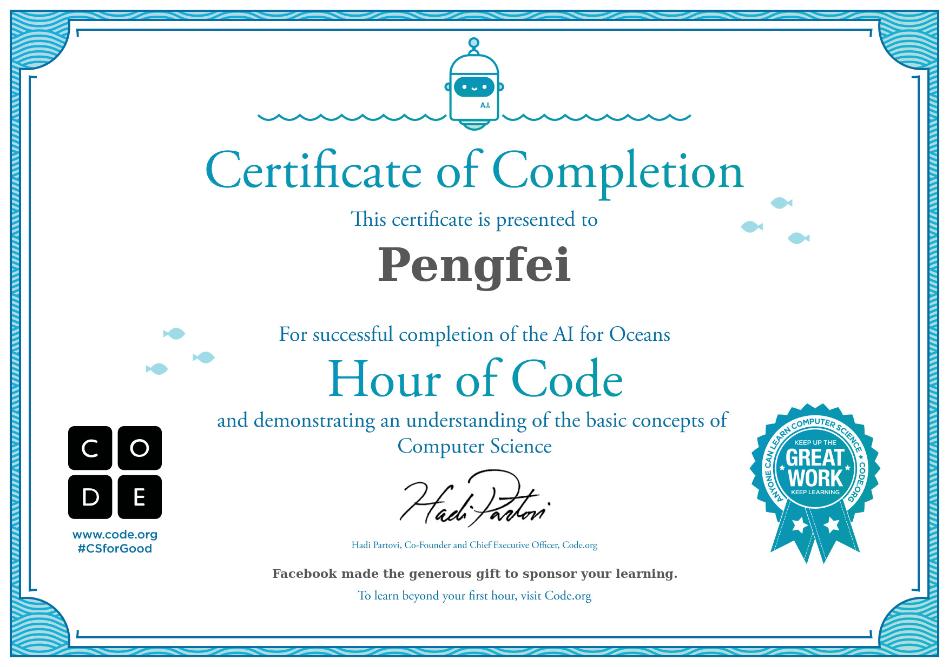
Extension: Teach A.I. a new word (L8)
https://studio.code.org/s/oceans/lessons/1/levels/8
Celebrate with our certificates
Notes:
https://www.youtube.com/watch?v=2hXG8v8p0KM

Slide 10
S2 Preparation: Learning about Annotation Roboflow
https://roboflow.com/
https://www.youtube.com/watch?v=a3SBRtILjPI
Training A.I. in Our real-world:
Image Capture → Annotation → Training → Testing
Teacher preparing textbooks
attending class
Examination

Slide 11

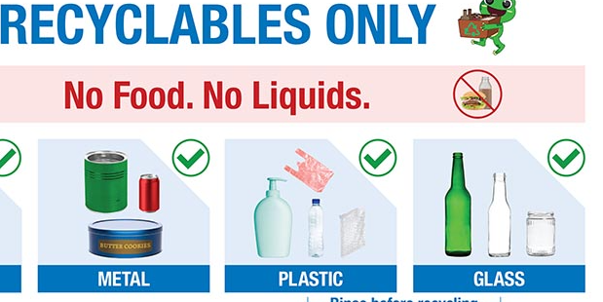
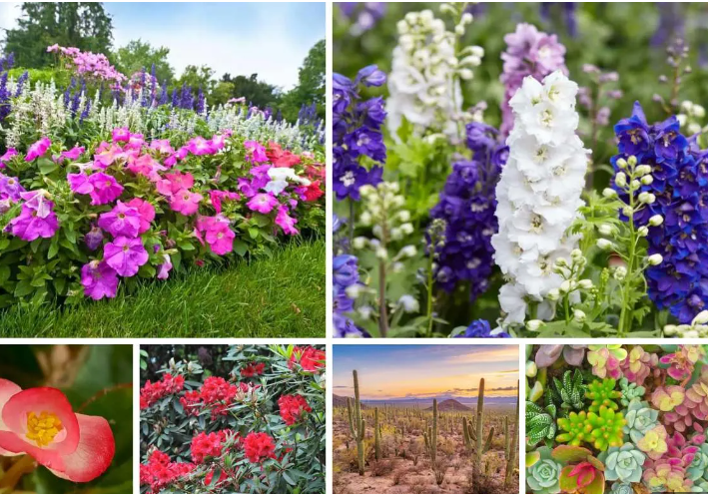
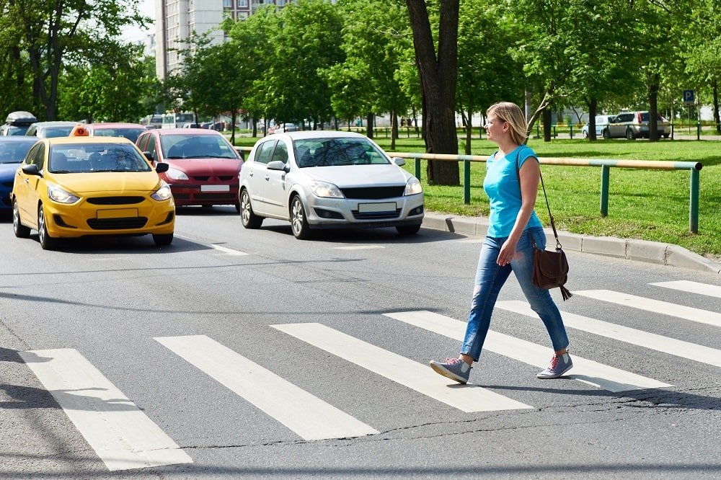
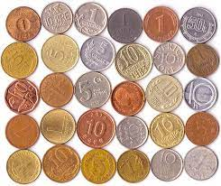
S2 Preparation: Group Task Selection
A. Person Protection Equipment (hats, goggles and vests)
B. Recyclables (Cans, Bottles, etc.)
C. Coins (5 cents, 1 dollar and 50 cents, etc.)
D. Pedestrians and Cars
E. Flowers and Plants

Slide 12
S2 Preparation: Group Task Selection
Image collection Online and Offline,
Let’s Start with Online Pictures First!!

Slide 13
Contact: Du Pengfei
du_pengfei@SIMTech.a-star.edu.sg

Slide 14
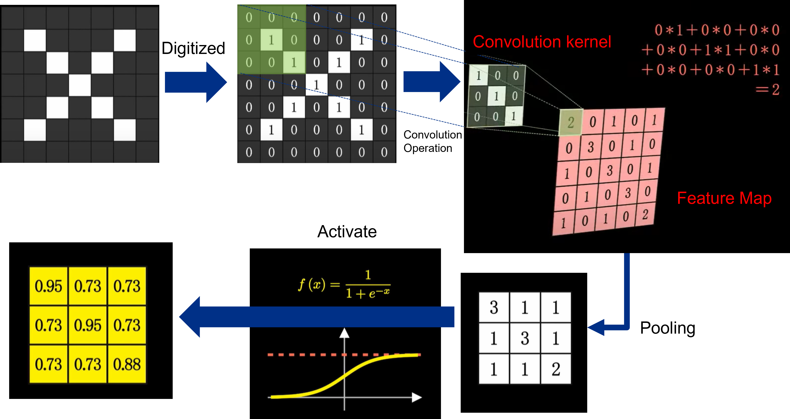
Extension: How computers see our world?
https://www.youtube.com/watch?v=2hXG8v8p0KM
Notes:
https://www.youtube.com/watch?v=2hXG8v8p0KM

Slide 15
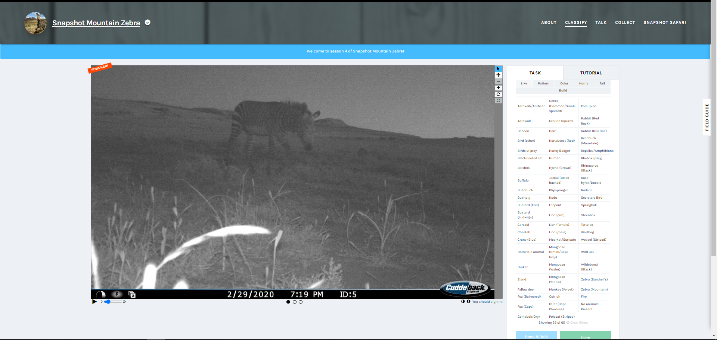
Extension: Help Classify Animals at Mountain Zebra National Park
https://www.zooniverse.org/projects/meredithspalmer/snapshot-mountain-zebra/classify?reload=0&workflow=11445
Help Classify Animals at Mountain Zebra National Park
Snapshot Safari has placed hundreds of hidden cameras across southern Africa, capturing millions of images of beautiful and rare animals.
Students can help protect the endangered Cape Mountain Zebra by classifying the different animals in these images. You can read about the project here or click below to give it a try!
Notes:
https://www.youtube.com/watch?v=2hXG8v8p0KM

